Slide 1
Chapter 11
Committed Romantic Relationships

Slide 2

Romantic Love
Romantic love consists of
-passion
-commitment
-intimacy

Slide 3
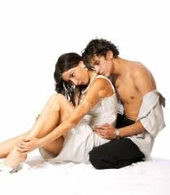
Passion
Intensely positive feelings and desires
Hard time sustaining
Ghost, 1min

Slide 4
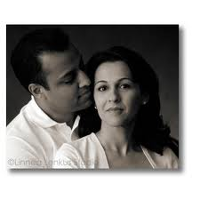
Commitment
Intention to remain
Stay in a relationship because
1. comfortable and pleasing
2. avoid negative consequences
Fun in the kitchen

Slide 5

Intimacy
Feelings of closeness, connection, tenderness
Are we porcupines?

Slide 6
Agree or Disagree

Slide 7
There is such a thing as love at first sight.

Slide 8
You can be friends with a past romantic partner.

Slide 9
You can fall in love multiple times.

Slide 10
I can love someone that I don’t like.

Slide 11
The person that I love will also be my best friend.

Slide 12
I will tell the person that I love everything.

Slide 13
As you wish

Slide 14
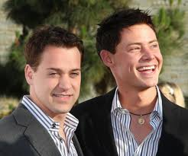
Primary Styles of Love
1. Eros – powerful, passionate
2. Storge- comfortable
3. Ludus- playful

Slide 15
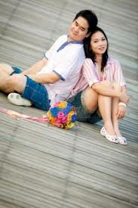
Secondary
4. Pragma- practical
What is your criteria?
5. Mania- manic (blend of ludic and eros)
6. Agape- generous and selfless (blend of eros and storge)

Slide 16
I want to tell my partner everything about me as soon as I fall in love.
My partner is my best friend.
I could only fall in love with someone who wants to have kids.
Love’s a game; I never take it too seriously.
I wish I could be sure Pat loves me. I worry all the time.
I am not looking for a committed relationship, just some fun.
I am happiest when my partner is happy.
I put their welfare and desires ahead of my own.

Slide 17
Romantic relationships follow a path.
Growth
Individuality
Invitational Communication
I’m interested
Explorational Communication
What are the possibilities?
Do you like jazz?
Intensifying Communication
Express thoughts and create culture
Revising Communication
What are our problems?
Commitment
Interviews
Notes:
Hooking up- 72% of all college students engag in some degree of sexual activity with a person with no expectation of seeing that person again. ---40% intercourse. 35% kissing and touching, 12% hand and genital contact. 12% oral sex.---(2012, Blackstrom)
African Americans are less likel to hook up. 35%. Caucasion 60%. (Jayson, 2011)

Slide 18
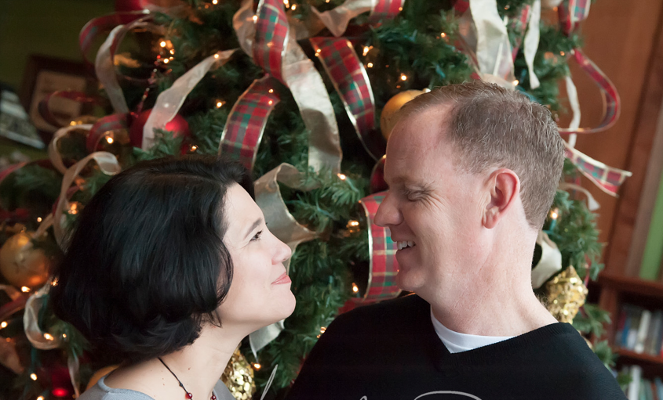
Navigation – adjusting, working through problems, accommodating
Relational culture- rules
Placemaking- creating your environment

Slide 19
Deterioration
Feeling of dissatisfaction
Breakdown of patterns, rules, rituals
Look for other social support
Accepting the end
“what if” is not healthy
Move on
500 Days

Slide 20
History
Late 19th Century – “calling”
Sat in parlor
1920’s – “date”
Courtship was about marriage.
Dating was about competion
After WWII – valued a stable and safe relationship
13 years old and didn’t date- late bloomer

Slide 21
Colonial Americans- intimacy in terms of physical not psychological
19th Century – Had a romantic self hidden within
Pressure to reveal themselves
Share true self, true feelings
Offered security and affirmation
1950’s – keep partner happy
1960’s – self-sacrifice replaced by self-fulfillment

Slide 22
Online Dating
19th Century – Newspaper personals
"Lonesome miner wants wife to share stake and prospects. Please respond to Louis Dreibelbis in Grass Valley, California.“
1980’s – Video dating
Who would you pick?

Slide 23
Online as we know it started in 1995.
Last year 17% of couples married
U.S.A. – 40 million
China – 140 million
India – 15 million
Average age of US user – 48
Data: A Love Story

Slide 24
Men Lie Most About
1. Age
2. Height
3. Income
Women Lie Most About
1. Weight
2. Physical Build
3. Age

Slide 25
What I’m doing with my life
I’m really good at
The first thing people notice about me
Six things I could never do without
Typical Friday night

